Slide 1

PAYMENT PLAN REPORT FORM PREPARATION INSTRUCTIONS
Leonard W. Carper
Data Quality Officer
UPDATED 09-18-2025 for CFY2526

Slide 2
Revisions Superseded (1)
This PowerPoint instructional presentation supersedes the following documents as dated:
Payment Plan Report Instructions 1007241022.pdf – date modified 10/07/2024 10:22 PM
Payment Plan Report Training 0919241043.pdf – date modified 09/19/2024 10:43 PM
Notes:
Ask the audience “WHEN” they believe they should ask questions. Then guide them to the answer of, “ANYTIME” during the presentation.

Slide 3
Revisions Superseded (2)
WHY ARE THE PREVIOUS INSTRUCTIONS NO LONGER USED?:
Changes were made to remove inaccurate information as identified by the Payment Plan Working Group.
Changes were made to align with changes made to the CFY2526 Clerk of Courts Monthly Payment Plan Report form.
CAN I STILL USE THE OLDER POWERPOINT?:
No. All previous instructions from the above instructional presentations are no longer valid.
Notes:
Ask the audience “WHEN” they believe they should ask questions. Then guide them to the answer of, “ANYTIME” during the presentation.

Slide 4
Purpose
Provide information and answer anticipated questions about:
STATUTORY REQUIREMENTS: Provides to the legislature an example of compliance with section 28.246(4), Florida Statutes, for satisfying financial obligations imposed by court proceedings.
DEMONSTRATED REVENUE COLLECTION/GENERATION: Identifies the effectiveness of using payment plans for collecting unpaid fines, fees, court costs, etc. within a particular court type.
EVALUATING COLLECTION EFFORTS: Supports revenue and collection effort trends reported on other CCOC reports and substantiates performance.
SUPPORTING ACTIONS TO IMPROVE: Provides reason for payment plan performance and provides a direction for any corrective action plan statements or descriptions.
Notes:
Ask the audience “WHEN” they believe they should ask questions. Then guide them to the answer of, “ANYTIME” during the presentation.

Slide 5
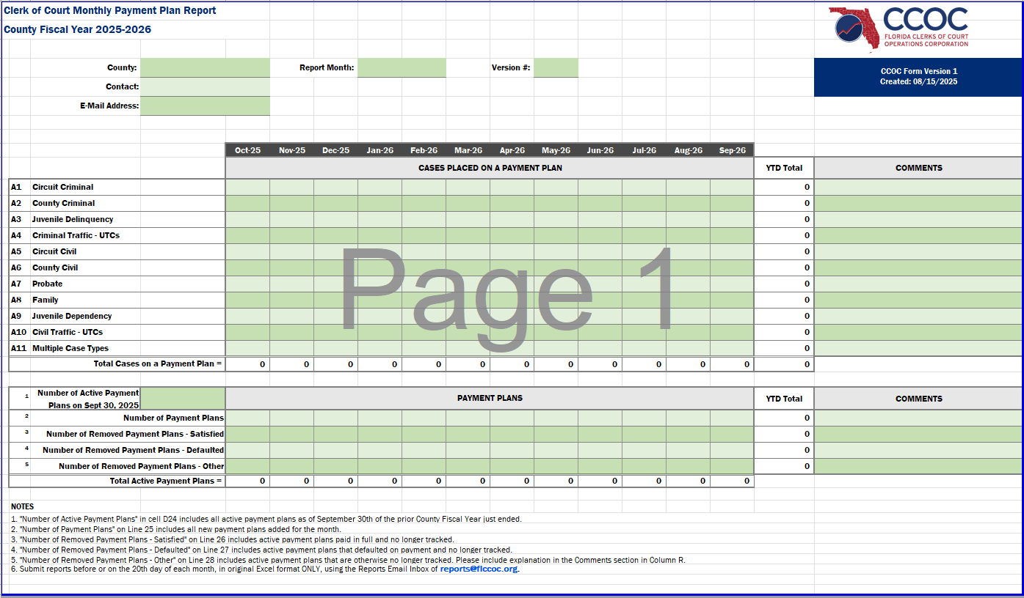
Sample Payment Plan Report
This report form would be used starting in September 2025
Notes:
Ask the audience “WHEN” they believe they should ask questions. Then guide them to the answer of, “ANYTIME” during the presentation.

Slide 6
General Report Form Submission
This report is to be completed and submitted in the original Excel format at the same time as all FLCCOC reports:
LOCATION OF REPORT FORM: All report forms used by FLCCOC are available on the FLCCOC website, by selecting “Forms & Instructions” in the dropdown menu of the “Clerk’s Budget” heading in the blue ribbon. Here is the direct URL: Forms & Instructions - Welcome to Florida Clerks of Court Operations Corporation (CCOC)
EMAIL SUBMITTER: The person identified as preparing the report in cells “D5” and “D6” may not be the same person who submits the report via email. In this situation, the preparer should be included on the CC line.
SUBMISSION: This report is due before or on the 20th day of the month following the end of the reporting period to reports@flccoc.org .
Notes:
Ask the audience “WHEN” they believe they should ask questions. Then guide them to the answer of, “ANYTIME” during the presentation.

Slide 7
General Report Form Completion
The report form has four general sections:
POINT OF CONTACT (POC) INFORMATION: Identifies the County Clerk’s Office being reported, the name of the person preparing the report, and the email of the person preparing the report. NOTE: This person may not be the same person who submits the report via email.
CASES PLACED ON PAYMENT PLANS: Records each court case placed on a payment plan using the court division in which the case is disposed (row) and the month in which the payment plan is initiated (column). Each case should be associated with a unique case number in the Clerk’s CMS.
PAYMENT PLAN DISPOSITION: Records status changes of each payment plan using the month the change occurs.
NOTES: Provides explanations of terms, proper reporting of data, changes made to the report form, statutory references, applicable dates, etc.
Notes:
Ask the audience “WHEN” they believe they should ask questions. Then guide them to the answer of, “ANYTIME” during the presentation.

Slide 8
General Report Form Completion Q&A
Questions…….?
Answers…….!
If a payment plan has met required payment terms for one case in a multi-case plan. Do we count that one case as satisfied and is the plan for all cases still open?
Count the one case satisfied for that court type in the month satisfaction occurred. The other cases would remain open until either satisfied or defaulted. And YES, the payment plan would remain open/active until ALL associated cases are paid.
When is a plan defaulted? Is it once a plan has a D6 notice created or when the case has a suspended license?
When a plan exceeds the payment due date grace period, it is in default.
Some counties do not suspend criminal cases. When are these defaulted?
Despite the use of suspensions in criminal cases the past due deadline has still been exceeded and should be defaulted if sent to a collection agency.
A payment plan that remains unpaid but has not defaulted. For example, death, short-term reincarceration, or long-term health/hospitalization events that prevent a person from working.
Could you define what we should put into the other category.

Slide 9
Counties Assigning One Case Per Plan
The One Case assignment to one Payment Plan relationship can take place throughout the report for the entire reporting period:
EXAMPLE: If four circuit criminal cases are placed on four payment plans in October, the amount in cell “E11” would include these 4 cases, and the amount in cell “E25” would include the 4 plans. The same is true for each court division, yielding an equal total of 38 cases placed on 38 payment plans, as reported in cell “E22” for October.
INTEGRATION OF CASE/PLAN RELATIONSHIPS : Since the total number of cases placed on payment plans in October (38) is equal to the number of Payment Plans established in October (38), it demonstrates there are only Payment Plans with a one-to-one case/plan relationship.
Notes:
Ask the audience “WHEN” they believe they should ask questions. Then guide them to the answer of, “ANYTIME” during the presentation.

Slide 10
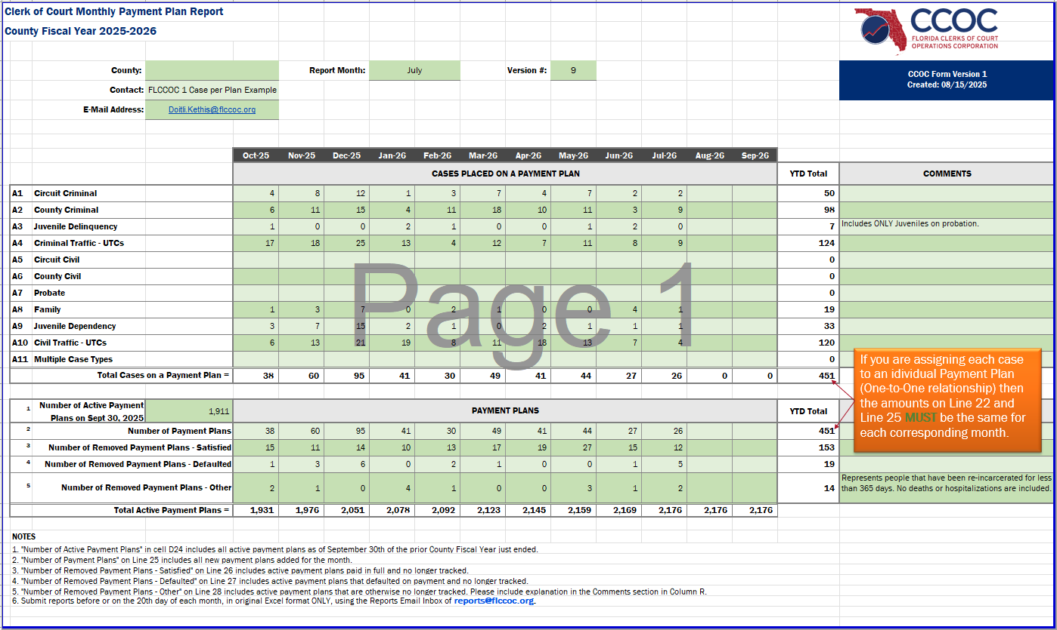
Sample Report: One Case Per Plan
Notice the amounts for “Total Cases on a Payment Plan” row EQUALS the “Number of Payment Plans” row
Notes:
Ask the audience “WHEN” they believe they should ask questions. Then guide them to the answer of, “ANYTIME” during the presentation.

Slide 11
Counties Assigning Multiple Cases Per Plan
The report form can easily accommodate the assignment of Multiple Cases to one Payment Plan relationship throughout the report for the entire reporting period:
EXAMPLE: If two circuit criminal cases are placed on one payment plan in October, the amount in cell “E11” would include these 2 cases, and the amount in cell “E25” would include the 1 plan. The same is true for each court division, yielding a total number of cases placed on a payment plan of 349 reported in cell “E22” for October.
INTEGRATION OF CASE/PLAN RELATIONSHIPS: Since the total number of cases placed on payment plans in October is 349, and there are only 38 payment Plans established in October, it should be obvious that there are few Payment Plans (possibly none) with a one-to-one case/plan relationship.
Notes:
Ask the audience “WHEN” they believe they should ask questions. Then guide them to the answer of, “ANYTIME” during the presentation.

Slide 12
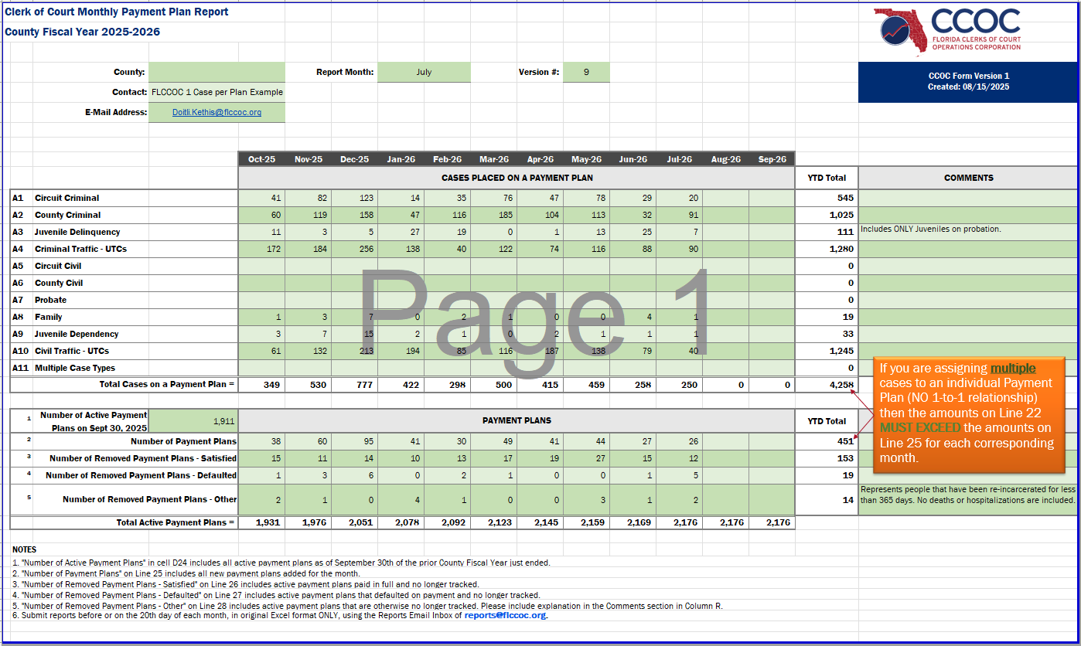
Sample Report: Multiple Cases Per Plan
Notice the amounts for “Total Cases on a Payment Plan” row EXCEED the amounts on “Number of Payment Plans” row
Notes:
Ask the audience “WHEN” they believe they should ask questions. Then guide them to the answer of, “ANYTIME” during the presentation.

Slide 13
Counties Assigning Unidentifiable Cases
There will be rare situations when cases cannot be directly associated with a single court division. Counties may place these cases on payment plans either singularly or collectively:
EXAMPLE 1: If two cases are adjudicated in both Circuit Civil and Probate, then placed on one payment plan in March, there would be no amount in cells “J5” or “J7” for these 2 cases, but the amounts in cell “J21” would include these 2 cases. The one payment plan is included in the amount in cell “J25” for March.
EXAMPLE 2: If one case is adjudicated in both the Juvenile Dependency and Family court divisions, then placed on one payment plan in November, the case would not be included in the case amounts in cells “F18” or “F19”, but the case would be included in the amount in cell “F21”. The one payment plan is included in cell “F25” for November.
Notes:
Ask the audience “WHEN” they believe they should ask questions. Then guide them to the answer of, “ANYTIME” during the presentation.

Slide 14
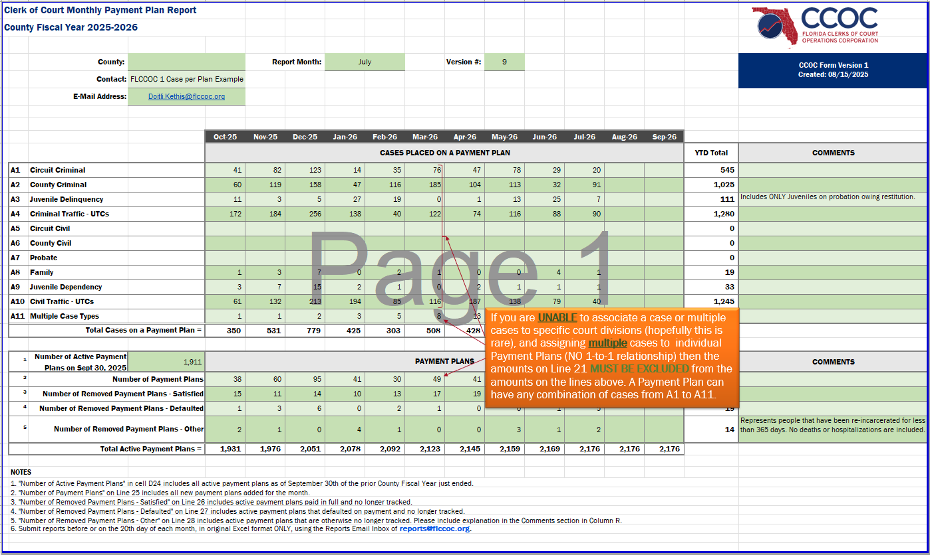
Sample Report: Unidentified Cases Per Plan
The cases reported as “Multiple Case Types” are ONLY reported here if you are UNABLE to identify the court division the case originates in.
Notes:
Ask the audience “WHEN” they believe they should ask questions. Then guide them to the answer of, “ANYTIME” during the presentation.

Slide 15
What DO I DO If This Happens?
These answers to anticipated questions about completing the report form under special situations are not all-inclusive.
Suppose not all court divisions assign multiple cases?: You still complete the report form as though all court divisions assign multiple cases to a single payment plan.
Suppose a person re-offends and is re-sentenced (Life or more)?: Contact the Florida Department of Corrections and have a judgment placed on any money earned while working in the incarceration facility.
Suppose a person violates probation and returns to complete their original sentence?: If the remaining sentence is a short period, you can use “Number of Removed Payment Plans – Other” if you only suspend the collection of payment. Otherwise, it is a Default.
Suppose I am just lost?: Contact a county in your peer group or CMS group.
Notes:
Ask the audience “WHEN” they believe they should ask questions. Then guide them to the answer of, “ANYTIME” during the presentation.

Slide 16
Questions? Don't hesitate to get in touch with Leonard Carper Lcarper@flccoc.org I will find you if you are lost….

